Slide 1
Content of chapter
Identify the central-level institutions/agencies supporting business enterprises.
Discuss the state-level institutions/agencies supporting business enterprises.
Explain various other agencies supporting business enterprises.
Notes:
1

Slide 2
Institutions Supporting Small-scale Industries
CENTRAL LEVEL
NBMSME
KVIC
The Coir Board
MSME –DO
NSIC
NSTEDB
NPC
EDI
NRDCI
NI - MSME
NIESBUD
IIE
STATE LEVEL
DIs
DICs
SFCs
SIDCs
SIADB
SSIs
OTHERS
NABARD
TCO
SIDBI

Slide 3
Central-level Institutions
National Board for Micro, Small & Medium Enterprises (NBMSME)
Khadi and Village Industries Commission (KVIC)
Coir Board
Micro Small Medium Enterprises Development Organisation (MSME–DO)
National Small Industries Corporation (NSIC)
National Science and Technology Entrepreneurship Development Board (NSTEDB)
National Productivity Council (NPC)
Entrepreneurship Development Institutes of India (EDI)
National Research Development Corporation of India (NRDCI)
National Entrepreneurship Development Institutes (NIMSME, NIESBUD, IIE)
Notes:
3

Slide 4
Central-level Institutions - NBMSME
The National Board for Micro, Small, and Medium Enterprises (NBMSME) was constituted in 2007 in pursuance of the MSME Development Act, 2006
Objective is to facilitate the coordination and inter institutional linkage for the development of MSME.
The NBMSME is an apex advisory body constituted to advise the government on all issues pertaining to the MSME sector.
The Union Minister of Commerce and Industry is the Chairman of the Board.
NBMSME comprises of 50 members including state industry ministers, select members of Parliament, public sector undertakings and eminent experts in the field as members.

Slide 5
National Board for Micro, Small, and Medium Enterprises
The board examines the factors affecting promotion and development of MSME
Advises the Central Government to facilitate their promotion and development in order to enhance competitiveness.
Broadly operates in areas such as policies and programmes; specific region such as the North East, ancillary development, quality improvement and marketing assistance; credit facilities, taxation and moderanization and industrial sickness.

Slide 6
Central-level Institutions - KVIC
The Khadi and Village Industries Commission (KVIC) is a statutory body established by an Act of Parliament (No. 61 of 1956).
KVIC functions under the administrative control of the Ministry of Micro, Small, and Medium Enterprises, Government of India.
The primary objective of KVIC is to provide employment to rural artisans through production of saleable products and to create self-reliance in order to build a strong rural community spirit.
Mahatma Gandhi started khadi and village industries to rejuvenate the rural economy as part of the freedom struggle. Khadi products are hand-spun and hand-woven. The spinning and weaving process creates opportunities for employment for a large number of spinners and weavers in rural India. More than 80 per cent among them are women.

Slide 7
The Khadi and Village Industries Commission
KVIC has been promoting the use of ecofriendly organic cotton and natural dyes. It deals with traditional rural industries such as pottery, leather, hand-made paper, non-edible oil, soap, and the processing of cereals and soaps. Due to the rigorous efforts of KVIC, khadi, which was seen as a cloth worn by the common man, has become glamorous.
The KVIC is entrusted with the task of planning, organizing, implementing, and promoting various programmes for the development of khadi and other village industries in rural areas.
The Commission provides financial assistance to institutions and individuals for the development of these industries and for guiding them through the supply of designs, prototypes, and other technical information.
It also creates common service facilities for the processing of raw materials and facilitates the marketing of the products through cooperative efforts.

Slide 8


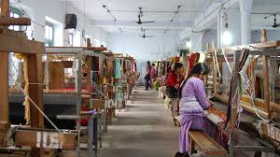


Slide 9
The Khadi and Village Industries Commission
The Government of India has taken a number of steps to promote exports of khadi and village industries products.
The designs are being improved upon in collaboration with premier institutions like the National Institute of Design (NID) and the National Institute of Fashion Technology (NIFT).
KVIC has promoted cluster development to meet market demands and the taste of all classes of consumers within and outside the country.

Slide 10
The Khadi and Village Industries Commission
KVIC has embarked on various initiatives to promote khadi and village industries in rural India.
The Prime Minister’s Employment Generation Programme (PMEGP);
Rural Employment Generation Programme (REGP);
Scheme of Fund for Regeneration of Traditional Industries (SFURTI);
Rural Industry Service Centres (RISC);
The export incentive scheme;
The interest subsidy scheme.

Slide 11
The Khadi and Village Industries Commission
KVIC also has taken various steps towards the welfare of artisans.
The Khadi Karigar Janashree Bima Yojana (JBY), a group insurance scheme, aims at enhancing the productivity and competitiveness of the khadi industry and artisans.
The Workshed Scheme for Khadi Artisans is an attempt to facilitate the development of khadi artisans by providing them financial assistance on a pilot basis for the construction of worksheds

Slide 12
Abbreviation | KVIC
Formation 1956 | 1956
Headquarters | Mumbai
Parent organization | MoMSMEs
Minister of MSME | Dinesh Patel
Chairperson | Kumud Joshi
Staff | Around 94 lacs
KVIC is a statutory body formed by the Government India.
Six zonal offices in Delhi Bhopal, Bangalore, Kolkata, Mumbai and Guwahati.

Slide 13



Slide 14
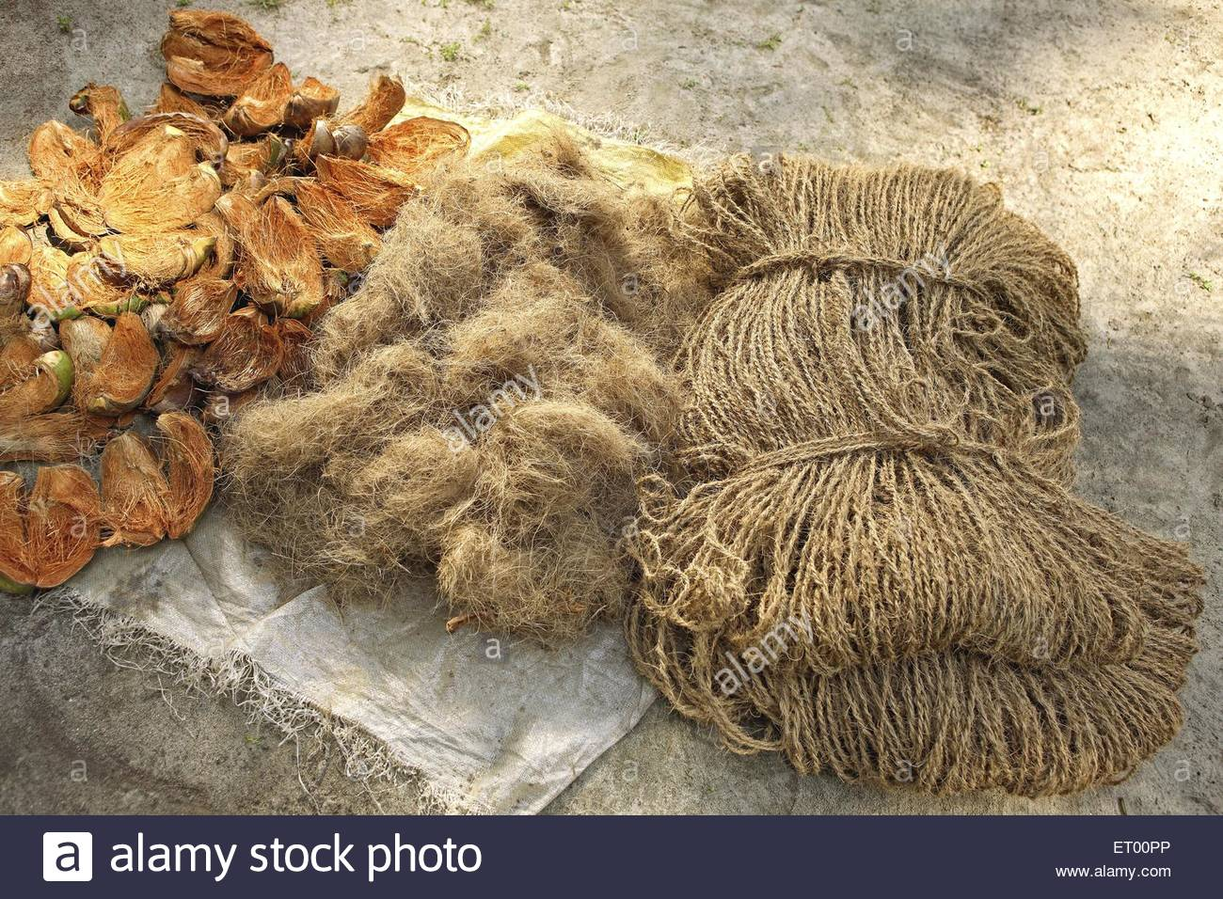

The Coir Board
The Coir Board is a statutory body established by the Government of India under the 'Coir Industry Act 1953 (45 of 1953)' for the promotion and development of the coir (coconut fibre) industry in India.

Slide 15
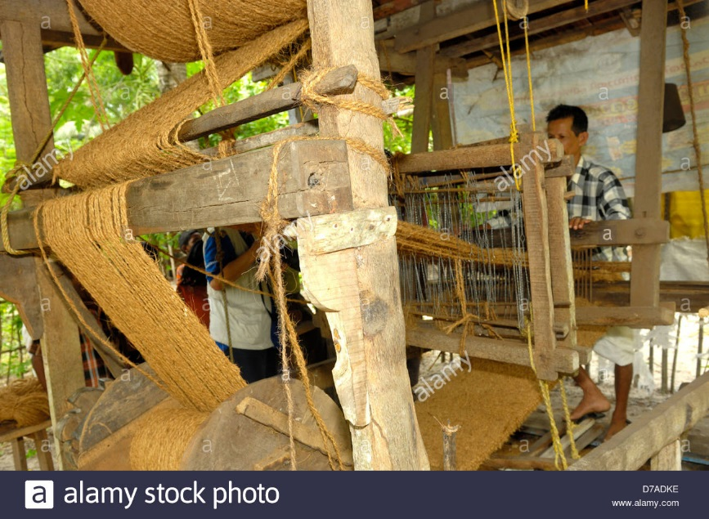



The Coir Board

Slide 16
Central-level Institutions - The Coir Board
The Coir Board is a statutory body established by the Government of India for the promotion and development of the coir industry under the Coir Industry Act, 1953, enacted by the Parliament.
This is one of the oldest traditional industries.
It generates value out of waste by providing eco-friendly products that generate large-scale employment and contribute to around INR 600 crore worth of exports annually.
The Coir Board has constituted various committees for implementing various functions such as the executive committee; the research and development committee; the export promotion committee; the marketing and publicity committee; the brown fibre development committee; and the Hindustan advisory committee.

Slide 17
The Coir Board
The Central Coir Research Institute, established in 1959, is the prime research centre of the Coir Board. It is recognized by the Department of Science and Technology, Government of India.
The Central Institute of Coir Technology is a research institute of the Coir Board established in 1979. These research institutes formulate Indian standards for coir products and provide extension services and technical assistance to coir entrepreneurs.
The Coir Board established the National Coir Training and Design Centre in 1965 for developing skilled manpower for the coir industry.
The Coir Board also established Hindustan Coir in 1968. Hindustan Coir promotes the mechanization of the coir industry on modern lines.

Slide 18
The Coir Board
The Government of India has embarked upon various initiatives for the rejuvenation, modernization, and technological upgradation of the coir industry.
Scheme of Fund for Regeneration of Traditional Industries (SFURTI);
Skill upgradation and quality improvement scheme;
Science and technology scheme;
Export market promotion scheme;
Domestic market promotion scheme;
Trade and industry related functional support services scheme;
Welfare measures scheme.

Slide 19
The Coir Board
In order to promote market development and the welfare of coir artisans, the Coir Board has promoted schemes such as
The marketing development assistance scheme
Personal accident insurance scheme for coir workers.

Slide 20
Central-level Institutions - MSME–DO
Micro, Small, and Medium Enterprises–Development Organization (MSME–DO) is the apex body for assisting the government in formulating, coordinating, implementing, and monitoring policies and programmes for the promotion and development of MSME in the country.
MSME–DO has over 60 offices and 21 autonomous bodies under its management
MSME–DO has a network of 30 MSME development institutes, 28 branch MSME development institutes, four MSME testing centres, seven MSME field-testing stations and two MSME departmental training institutes.
These institutes conduct consultancy, training, and provide common facility services to MSME.

Slide 21
MSME–DO
MSME has initiated various schemes for the promotion of the MSME sector in India. These are: Small Enterprise Information and Resource Network; entrepreneurship development programmes; management training programmes; WTO cells; motivation campaigns; skill-development programmes; and initiatives for environmental control.
MSME–DO has a library at its headquarters at Nirman Bhawan, New Delhi, and at all its field institutes in the country. The objective of providing information for entrepreneurs about new developments taking place in the industrial and business environment.

Slide 22
Central-level Institutions - NSIC
Established in 1955 by GOI
National Small Industries Corporation (NSIC)
It falls under Ministry of Micro, Small & Medium Enterprises of India.
NSIC is the nodal office for several schemes of Ministry of MSME such as Performance & Credit Rating, Single Point Registration, MSME Databank, National SC ST Hub, etc.
The NSIC has obtained ISO 9001–2008 certification and operates through a countrywide network of offices and technical centres.
Providing financial assistance for the procurement of raw materials for up to 90 days; finance through syndication with banks; and facilitating import of scarce raw materials.

Slide 23
National Small Industries Corporation
To support MSME in their marketing efforts, programs conducted like Consortia and tender marketing; single-point registration for government purchase; B2B web portal for marketing; marketing intelligence; exhibition and technology fairs; export; and buyer–seller meets.
In order to evaluate the strengths and weaknesses of existing operations and to take corrective and preventive actions, the NSIC has started operating a performance
Credit rating scheme through agencies such as ICRA, ONICRA, CRISIL, Fitch, CARE, Brickwork Ratings, and SMERA.
Due to consistent good performance, Accorded it the “Mini Ratna” status
NSIC are Icon of the Year, Meri Dilli, Small Business Mentor of the Year, and the FSIA–V. B. Gulati Award.

Slide 24
Central-level Institutions – NSTEDB
National Science and Technology Entrepreneurship Development Board
Established in 1982, by the Government of India under the aegis of Department of Science and Technology, NSTEDB is an institutional mechanism to help promote knowledge-driven and technology-intensive enterprises.
The Board, with representations from socio-economic and scientific ministries/departments, aims to convert “job-seekers” into “job-generators” through Science and Technology (S&T) interventions.
NSTEDB functions under the aegis of Department of Science & Technology. It has representation from socio-economic and scientific Departments / Ministries, premier entrepreneurship development institutions and all India Financial Institutions.
Current - Prof. Ashutosh Sharma (Secretary)

Slide 25
National Science and Technology Entrepreneurship Development Board
The major objectives of NSTEDB are :
To promote knowledge based and innovation driven enterprises.
To facilitate generation of entrepreneurship and self-employment opportunities for S & T persons.
To facilitate the information dissemination.
To network with various Central & State Government agencies for S&T based entrepreneurship development.
To act as a policy advisory body to the Government agencies for S&T based entrepreneurship development.
To generate employment through technical skill development using S & T infrastructure.

Slide 26
National Science and Technology Entrepreneurship Development Board
Institutional support is provided through the Innovation and Entrepreneurship Development Centre (IEDC); the Science and Technology Entrepreneurship Development (STED) project; the Science and Technology Entrepreneurs Park (STEP); and the Technology Business Incubator (TBI).
The NSTEDB conducts various training programmes through Entrepreneurship Development Cells.
The various training programmes conducted by the Board are Entrepreneurship Awareness Camp (EAC), Entrepreneurship Development Programme (EDP), and Faculty Development Programme (FDP) focusing on the entrepreneurship domain, and the Technology-based Entrepreneurship Development Programme (TEDP).
The Board publishes a magazine titled Science Tech Entrepreneur and has hosted a Web portal named “TIME IS” for the dissemination of information for promoting entrepreneurs. Some of the major activities undertaken by NSTEDB are elaborated on this Web portal.

Slide 27
National Science and Technology Entrepreneurship Development Board
Major activities of NSTEDB
Training programmes;
Institutional mechanisms for entrepreneurship development; and
Information dissemination.
More programmes are being evolved to suit the changing socio-economic scenario and the available scope for entrepreneurship development.

Slide 28
Central-level Institutions – NPC
National Productivity Council (NPC)
Autonomous institution functioning under the overall supervision of the Ministry of Industry, GOI, in 1958
Primary objective is to act as a catalyst in enhancing the productivity of all sectors of the economy, including industry and agriculture
Administered by a tripartite Governing Council (GC) which has equal representation from the government, industry and trade unions
Provide tailor-made solutions to agriculture and industry
These divisions, operated by trained consultants, deal with issues related to industrial engineering, plant engineering, energy management, HRD, informal sector, agriculture.

Slide 29
National Productivity Council
NPC is a member of the Asian Productivity Organization (APO), Tokyo, an umbrella body of all productivity councils in Asian region
To channelize expertise of NPC to small-scale and informal sector, SIDBI has tied-up with NPC for enhancing technology in small units.
NPC teams up with its clients to work out solutions towards accelerating productivity, enhancing competitiveness, increasing profits, augmenting safety and reliability and ensuring better quality. It provides reliable database for decision-making, improved systems and procedures, work culture as well as customer satisfaction both internal & external.
NPC’s services have bearings on economic growth and quality of life.
Productivity focused on improving triple bottom line – economic, environmental and social and adds value for all the stakeholders through generation & application of advanced knowledge for inclusive Growth.

Slide 30
National Productivity Council
The NPC’s head office is based in New Delhi and regional offices are spread across India at Chandigarh, Kanpur, Gandhinagar, Bhopal, Mumbai, Patna, Kolkata, Guwahati, Hyderabad, Bangalore, Chennai, Jaipur, and Bhubaneshwar.
Training institute, the Dr Ambedkar Institute of Productivity (AIP) in Chennai. The Institute prepares and develops consultants in managerial and technical areas to cater to the needs of the NPC. It trains consultants for absorption into the NPC and also the industry on a sponsored or self-financing basis.
The AIP conducts a two-year post-graduate diploma programme in industrial engineering, plant engineering, industrial pollution prevention and control, energy management, human resources management, productivity research, inter-firm comparison, total quality management, total productivity management, and agricultural productivity.

Slide 31
National Productivity Council
The NPC provides consultancy services to enhance the quality and productivity of Indian industries such as agri-business services, economic services, energy management, environment management, human resource management, information technology, process management, and technology management.
Productivity is the principal journal published quarterly by the NPC in India.
The journal disseminates information on concepts, techniques, and data in the area of productivity and its growth in India and abroad. The articles in the journal are written and the issues addressed by top-level and senior-management technologists, policy makers, educationists, and researchers

Slide 32
Central-level Institutions – EDII
Entrepreneurship Development Institute of India (EDII)
The Entrepreneurship Development Institute of India, Ahmedabad, is an autonomous non-profit institution, set up in 1983.
Sponsored by financial institutions, such as
Industrial Development Bank of India (IDBI),
Industrial Finance Corporation of India (IFCI),
Industrial Credit and Investment Corporation of India (ICICI),
State Bank of India (SBI).
The Government of Gujarat has also provided assistance for the setting up of EDII.
EDII has been spearheading an entrepreneurship movement throughout the nation in the belief that entrepreneurs need not necessarily be born, they can be developed through well-conceived and well-directed activities.

Slide 33
Entrepreneurship Development Institute of India
Objectives
Augment the supply of trained entrepreneurs through training
Generate a multiplier effect on opportunities for self-employment
Improve managerial capabilities of small-scale industries
Contribute to the dispersal of business ownership and thus expand the social base of the Indian entrepreneurial class
Contribute to the creation and dissemination of new knowledge and insight into entrepreneurial theory and practice through research

Slide 34
Entrepreneurship Development Institute of India
Objectives
Participate in institution-building efforts
Sensitize the support environment to facilitate potential as well as existing entrepreneurs to establish and manage their enterprises
Promote micro enterprises at the rural level
Inculcate the spirit of ‘entrepreneurship’ amongst youth
Collaborate with similar organisations in India and other developing countries to accomplish the above objectives.

Slide 35
EDII - Training Programs
Entrepreneurship in education
Programmes launched are the Post Graduate Diploma in Management–Business Entrepreneurship (PGDM–BE); the Post Graduate Diploma in Management–Development Studies (PGDM–DS); and the Diploma in Entrepreneurship and Business Management. The Institute also conducts international programmes sponsored by the Ministry of External Affairs, Government of India.
It offered Diploma in Entrepreneurship and Business Management and Diploma in Social Entrepreneurship. The Diploma in Entrepreneurship and Business Management is an online course and is recognized by the Distance Education Council, IGNOU, New Delhi.
The Diploma in Social Entrepreneurship is a six-month programme providing a unique opportunity to learn about and start a social enterprise and to contribute towards the social development of our country.

Slide 36
Entrepreneurship Development Institute of India
The EDI campus is located in a rural area amidst verdant surroundings spread over 23 acres of land in Gandhinagar district, Gujarat, India.
It is one of the best maintained educational campuses in the world
The campus was awarded the prestigious “Aga Khan Award for the Best Architecture” in 1992.
The EDI has been selected as a member of the Economic and Social Commission for Asia and the Pacific (ESCAP) network of centres of excellence for HRD research and training. As a member of the network,
The EDI will have interactive access to information on the other 123 member institutions via the Internet.

Slide 37
Entrepreneurship Development Institute of India
In order to promote entrepreneurship at the school and college level, the EDI conducts summer camps and entrepreneurship awareness programmes for children and the youth.
To promote entrepreneurial education and training in India, the EDI conducts a faculty development programme in entrepreneurship.
The Institute organizes national seminars on approaches to entrepreneurship education and deliberates on the establishment of entrepreneurship and business development centres (EBDCs) in educational institutions.

Slide 38
National Research Development Corporation of India (NRDCI)
Established in 1953
Presently working under the Department of Scientific and Insustrial Research, Ministry of Science and Technology
It has exported services to United States, Grmany, Malasia, Brazil, Bangladesh, Burma, Nepal, Senegal, Madagascar, Indonesia, The Philippines, Vietnam, Sri Lanka, Kenya, and Egypt
The vision is to be provider of world-class business services that nurture technological ideas in Indian minds, to ensure their propagation in world markets, and to satisfy human needs.

Slide 39
National Entrepreneurship Development Institutes (NIMSME, NIESBUD, IIE)
National Institute for Micro, Small, and Medium Enterprises (NI-MSME)
It is registered under the Public Societies Registration Act effective from 1 July 1962 and is located at Hyderabad in Andhra Pradesh
It is a premier institute in India for the promotion, development, and modernization of the MSME sector.
The Small Enterprises Development, Management, Extension(SEDME) is a quarterly journal published by the Institute.
The contributors to SEDME include policy makers, researchers, academicians, financiers, executives, and other officials associated with MSME activities from India and other developing as well as developed countries.

Slide 40
National Entrepreneurship Development Institutes (NIMSME, NIESBUD, IIE)
National Institute for Micro, Small, and Medium Enterprises (NI-MSME)
The infrastructure and facilities at the NI-MSME campus are at par with international standards. The Institute is now being recognized as among the best training, research, and extension facilities in the world.
The NI-MSME has an interface with several international agencies such as the Commonwealth Fund for Technical Cooperation (CFTC), the United Nations Educational Scientific and Cultural Organization (UNESCO), the United Nations Development Programme (UNDP), the United States Agency for International Development (USAID), the International Labour Organization (ILO), the Ford Foundation, and GTZ of Germany.

Slide 41
National Entrepreneurship Development Institutes (NIMSME, NIESBUD, IIE)
National Institute for Entrepreneurship and Small Business Development (NIESBUD)
Founded in 1983 by the Ministry of MSME, Government of India
Presently functioning from its integrated campus in Noida, Delhi.
The NIESBUD has joined hands and signed a Memorandum of Understanding (MoU) with the International Finance Corporation (IFC), a member of the World Bank group, for jointly undertaking different projects relating to entrepreneurship development in India.
The NIESBUD will collaborate with the IFC in conducting the training of trainers (TOT) programme to create a cadre of master trainers who would, in turn, replicate the model to impart training for the MSME sector in a much bigger way.
The NIESBUD mission is to promote, support, and sustain entrepreneurship and MSME through training, education, research, consultancy, and other interventions throughout the globe.

Slide 42
National Entrepreneurship Development Institutes (NIMSME, NIESBUD, IIE)
Indian Institute of Entrepreneurship (IIE)
Established in 1993, its headquarters at Guwahati.
The Institute has a governing council headed by the chairman of the North East Council (NEC)
The IIE was specially developed to address the needs of the north-eastern hill states with a view to market and develop traditional and handicraft industries
t organizes seminars, workshops, and conferences for providing a forum for interaction and exchange of views by various agencies and entrepreneurs.

Slide 43
Central-level Institutions - Summary
The NBMSME is an apex advisory body constituted to advise the government on all issues pertaining to the MSME sector.
The primary objective of KVIC is to provide employment to rural artisans through the production of saleable products and to create self-reliance in order to build a strong rural community spirit.
The Coir Board is a statutory body established by the Government of India for the promotion and development of the coir industry in the country.
MSME–DO is the apex body for assisting the government in formulating, coordinating, implementing, and monitoring policies and programmes for the promotion and development of MSME in the country.

Slide 44
Central-level Institutions - Summary
The NSIC provides a package of services and various schemes to support MSME in the country.
The NSTEDB was established with the primary objective of promoting self-employment amongst the Science and Technology (S&T) manpower in the country and to set up knowledge-based and innovation-driven enterprises.
NPC , an autonomous, tri-partite, non-profit organization, which aims to promote a culture of productivity in India.
The EDI has been spearheading the entrepreneurship movement throughout the nation and developing entrepreneurs through well-conceived and well-directed activities. The EDI is committed to entrepreneurship education, training, and research.
The NRDCI facilitates the supply of technologies and services to entrepreneurs in both developing and developed countries.
There are three national entrepreneurship development institutes set up by the Ministry of Industries. These are NI-MSME at Hyderabad, NIESBUD at New Delhi, and IIE at Guwahati.
Notes:
44

Slide 45
State-level Institutions
The state-level institutions for supporting entrepreneurial activities are set up by the various states governments in India.
State Directorate of Industries
District Industries Centre’s (DIC)
State Financial Corporation’s (SFC)
State Industrial Development Corporation (SIDC)
State Industrial Area Development Board (SIADB)
Notes:
45

Slide 46
State-Level Institutions
DIC are district-level institutions set up by the government, which provide all services and facilities to entrepreneurs in one place to set up MSME.
The important services provided by SFC to MSME are infrastructure development, financial services, and term loans.
SIDC provide infrastructural facilities to MSME in the form of industrial land, industrial shed, roads, power, water supply, drainage, and other amenities required for industrial development.
The SIADB acquires and provides developed land suited for industries.

Slide 47
1. State Directorate of Industries
Directorate of Industries (DIs) – At the State level, the Commissioner/ Director of Industries implements policies for the promotion and development of small-scale, cottage, medium and large scale industries.
The Central policies for the SSI sector serve as guidelines but each State evolves its own policy and package of incentives.
The Commissioner/ Director of Industries works for all the States

Slide 48
2. District Industries Centers (DICs)
In order to extend promotion of small-scale and cottage industries to district headquarters, DIC program was initiated in May, 1978, as a centrally sponsored scheme.
Objective of greater employment opportunities especially in rural and backward areas in the country.
At present DICs operate under respective State budgetary provisions.
Services and Support to small entrepreneurs are provided under a single roof through the DICs
Registration of small industries is done at the District Industries Centres
The organizational structure of DICs consists of one General Manager, 4 Functional Manager and three Project Managers to provide technical service.
Management of the DICs is done by the State Governments

Slide 49
Functions of DICs
To prepare action plan to effectively implement the schemes identified
To assist the entrepreneurs in marketing their products and assess export promotion of their products.
To undertake product development work appropriate to small industries.
To guide entrepreneurs in matters relating to selecting the most appropriate machinery and equipment
To appraise the worthiness of the various proposals received from entrepreneurs.

Slide 50
DICs extend services of the following nature
(i) Economic investigation of local resources
(ii) Supply of machinery and equipment
(iii) Provision of raw materials
(iv) Arrangement of credit facilities
(v) Marketing
(vi) Quality inputs
(vii) Consultancy

Slide 51
3. State Financial Corporation - SFCs
SFCs are helpful in ensuring balanced regional development, higher investment, more employment generation and broad ownership of industries.
At present there are 18 state finance corporations (out of which 17 SFCs were established under SFC Act 1951).
The State Finance Corporations management Board of ten directors. The State Government appoints the managing director generally in consultation with the Reserve Bank.
The insurance companies, scheduled banks, investment trusts, co-operative banks and other financial institutions elect three directors. Thus the majority of the directors are nominated by the government and quasi-government institutions.

Slide 52
Objectives
1. To provide term loan for purchase of land, buildings, machinery and other facilities.
2. To promote self-employment for professionally qualified men and women entrepreneurs interested in starting their own projects.
3. Financial assistance for expansion , modernization and mechanization in the existing set up.
4. Financial assistance for rehabilitation of sick units.
5. To give financial assistance for transport vehicles and tourism related activities.
6. To entrepreneurial development programmes and seminars for up coming young industries.
7. To provide financial assistance for quality improvement and environmental control needs.

Slide 53
Functions:
(i) The SFCs grant loans mainly for acquisition of fixed assets like land, building, plant and machinery.
(ii) The SFCs provide financial assistance to industrial units whose paid-up capital and reserves do not exceed Rs. 3 crore (or such higher limit up to Rs. 30 crore as may be specified by the central government).
(iii) The SFCs underwrite new stocks, shares, debentures etc., of industrial concerns.
(iv) The SFCs provide guarantee loans raised in the capital market by scheduled banks, industrial concerns, and state co-operative banks to be repayable within 20 years.

Slide 54
4. State Industrial Development / Investment Corporation (SIDC/SIIC)
Set up under the Companies Act, 1956, as wholly owned undertakings of the State governments, act as catalysts in respective states.
SIDC helps in developing land providing developed plots together with facilities like roads, power, water supply, drainage and other amenities.
They also extend assistance to small-scale sector by way of term loans, subscription to equity and promotional services.
11 out of 28 SIDCs in the country also function as SFCs and are termed as Twin-function IDCs

Slide 55
5. State Small Industrial Development Corporations (SSIDC)
Established under Companies Act, 1956, as State government undertaking, caters to small, tiny and village industries in respective states.
Being operationally flexible undertakes the activities like
(i) procure and distribution of scarce raw materials,
(ii) supply of machinery to SSI units on hire-purchase basis,
(iii) product marketing assistance,
(iv) construction of industrial estates, allied infrastructure facilities and their maintenance
(v) extending seed capital assistance on behalf of State government and
(vi) providing management assistance to production units

Slide 56
Other Institutions
National Bank for Agriculture and Rural Development (NABARD)
Housing and Urban Development Corporation (HUDCO)
Technical Consultancy Organizations (TCO)
Small Industries Development Bank of India (SIDBI)
Export Promotion Council (EPC)
Industry Associations
Non-Governmental Organizations (NGOs)
Business Incubators.
Notes:
56

Slide 57
1. National Bank for Agricultural and Rural Development (NABARD)
NABARD was set up in July 1982
To provide refinance assistance to State Cooperative Banks, Regional Rural Banks, and other approved institutions for all kinds of production and investment credit to small-scale industries, artisans, cottage and village industries, handicrafts, and other allied activities.
NABARD also helps SSI entrepreneurs to get loan for setting up small-scale industries in any part of the country.

Slide 58
1. National Bank for Agricultural and Rural Development (NABARD)
Primary Goal - is to promote sustainable and equitable agriculture and rural prosperity through effective credit support, related services, institution development, and other innovative initiatives.
Functions - credit planning; financial services; promotion and development; and supervision.
Supporting Function - formation and linkage of self-help groups; farmers’ clubs; rural infrastructure development funds; watershed development; the Kisan Credit Card; the district rural industries project; women and development; the Rural Entrepreneurship Development Programme (REDP); rural marketing; NABARD Consultancy Services (NABCONS); co-financing; cluster development programmes; and the Rural Innovation Fund.
The subsidy schemes - animal husbandry and poultry development including poultry venture capital fund; cold storages; rural godowns; and solar lighting and photovoltaic cells schemes.

Slide 59
2. Housing and Urban Development Corporation Ltd. (HUDCO)
HUDCO, as a wholly owned company of the Government of India,
was incorporated in April 1970 as a private limited company and subsequently, converted into a public limited company in 1986.
Though HUDCO's primary objective is to provide assistance for urban, social sector infrastructure, and the creation of housing facility, of late, the Corporation has undertaken activities to create infrastructure for the SSI sector.
HUDCO also extends assistance for the promotion of building material industries, besides imparting consultancy, training and technical assistance in related matters.

Slide 60
Aims - to promote sustainable habitat development to enhance the quality of life.
HUDCO was established with an equity base of ₹2 crore.
Product portfolio - housing, urban infrastructure, building technology promotion, research and training, and consultancy.

Slide 61
3. Technical Consultancy Organisations (TCOs)
TCOs were set up by the all-India financial institutions during the 1970s and 1980s (in association with State-level financial/development institutions and commercial banks)
To cater the consultancy needs
TCOs provide a total package of consultancy services to small-and medium-scale enterprises, individual entrepreneurs, government departments and agencies, various State-level institutions, commercial banks, and other institutions for activities relating to industrial development and financing.

Slide 62
Functions
Preparing project profiles and feasibility studies;
Identifying of potential entrepreneurs and provision of technical and management assistance to them;
Undertaking market research and surveys for specific products;
Undertaking export consultancy for export-oriented projects based on modern technology;
Offering management consultancy services especially for diagnostic study of sick units
Conducting entrepreneurship development programmes and skill up-gradation programmes.

Slide 63
4. Small Industries Development Bank Of India (SIDBI)
Origin and objectives
The Small Industries Development Bank of India was established in April 1990 under an Act of Indian Parliament as the principal financial institution for
promotion;
financing;
development of industry in the small-scale sector; and
coordinating the functions of other institutions engaged in similar activities.
SIDBI Assist - the tiny, village, and cottage industries through suitable schemes tailored to meet the requirement setting up new projects, expansion, diversification, modernisation, and rehabilitation of existing units.

Slide 64
Objectives - to empower the MSME sector with a view to contribute to the process of economic growth, employment generation, and balanced regional development.
Functions - the development of MSME sector are financing, promotion, development, and coordination. SIDBI finances technology transfer and upgradation, quality improvement programmes, export promotion, environmental care, and rural industrialization.
SIDBI as an apex institution makes use of the existing network of banks and state-level financial institutions to convey financial assistance to the MSME sector.

Slide 65
Development and support services
Enterprise promotion with emphasis on rural industrialisation
Human resource development to suit the SSI sector needs
Technology upgradation
Quality and environment management
Marketing and promotion
Information dissemination

Slide 66
5. Export Promotion Councils (EPCs)
Objective - to overcome problems in the marketing of MSME products in the overseas markets,
Functions - to promote the exports of their member units through direct marketing, developing vendor relations, opening respective sales outlets abroad, and so on, as a collective export marketing strategy. The activities of different councils are targeted to increase the exports from the sector.
Councils - to export-related services from the councils, bulk purchase orders from foreign buyers and distribute these among member units for supply to the council for onward export.
To whom Provide Service - to existing as well as new members by providing information about the developments taking place in the international arena.
Which information are provide - changes with regard to export–import policies and procedures, customs and excise duty rules, and so on. Besides trade enquiries, tender notices are circulated among members in order to assist them to avail the business opportunities for augmenting overall exports.

Slide 67
6. Industry Associations
Objectives - provide MSME with a common platform to raise industry-related issues and to initiate cooperative efforts for promoting the sector.
Roles - common facilities and other cooperative ventures in the areas of technology, marketing, and other support services.
Major Association
6.1 Confederation of Indian Industry (CII)
In 1895, five British engineering firms formed the Engineering and Iron Trade Association (EITA).
EITA was renamed the Indian Engineering Association (IEA) in 1912.
With the swadeshi movement gaining momentum, the Engineering Association of India (EAI) was formed in 1942 by a group of indigenous entrepreneurs.
IEA and EAI were merged in 1974 to form the Association of Indian Engineering Industry (AIEI).
The 1980s ushered in an era of competiveness and liberalization, and the AIEI was renamed the Confederation of Engineering Industry (CEI).
In 1992, the name was again changed to the Confederation of Indian Industry (CII), which reflected the extension of the confederation’s coverage.

Slide 68
The main objectives - CII are to provide information, advisory, consultative, and representative services to industry and the government.
It also organizes industry exhibitions, specialized sectoral trade fairs, and the India Engineering Trade Fair and promoting international industrial cooperation.
6.2 Federation of Associations of Small Industries of India (FASII) set up in 1959, represents associations of small industries and individual SSI units.
Objectives - (i) to promote the development of MSME and cottage industries; (ii) to cooperate with industrial, business, educational, and research institutions in collecting and exchanging information pertaining to MSME; (iii) to undertake professional, technical, and management consultation services; (iv) to undertake studies, surveys, and research assignments; (v) to further the cause of MSME by interacting with union and state governments and other bodies; (vii) to establish test centres, laboratories, and common facility centres for the MSME sector.
Functions - organizing meetings/conferences, liaising with policy makers, analysing and interpreting policies, and taking up members’ difficulties with the concerned department/organization for redressal.

Slide 69
6.3 Laghu Udyog Bharati (LUB)- established in 1995.
Objective -to promote and safeguard the interests of the small-scale industry.
Functions - Entrepreneurial training, support for technology upgradation, and marketing are within the extended scope of its activities, representation in the national and state-level government bodies connected with MSME.
6.4 Indian Council of Small Industries (ICSI) founded in 1979
represents around 1,500 associations of the decentralized sector.
Objectives of the council include extending help to MSME, cottage enterprises, and artisans.
Aims - at enhancing the contribution of the MSME sector in the overall growth of the Indian economy.
Functions - ICSI are consultancy, information dissemination, entrepreneurship development, training, research, and so on

Slide 70
6.5 Council of Scientific and Industrial Research (CSIR) The CSIR has set up a large number of Regional Research Laboratories all over the country, which are developing new processes for the manufacture of industrial products on a commercial scale. These agencies act as pillars of support for the promotion and growth of MSME in India.

Slide 71
7. Non-governmental Organisations (NGOs)
the Central and State governments and autonomous bodies, there has been an emergence of NGOs in different States to provide financial assistance, information, training, marketing support, legal advice, and so on to SSIs.
The 1991 SSI policy of the Government of India favoured assistance to SSIs through NGOs.
A few training programmes for unemployed youth to help set up industries under the PMRY, have been assigned by State governments to some NGOs.
In the present scenario, the role of NGOs is assuming importance for assistance to entrepreneurs, particularly under micro-financing activities.

Slide 72
8. Business Incubators
Functions - to accelerate the growth and success of entrepreneurial companies through an array of business support resources and services that could include physical space, capital, coaching, common services, and networking connections.
It plays the role of an accelerator to start-up ventures.
Business incubators are shared office-space facilities that incubate with a strategic, value-adding intervention system through mentoring, business assistance, and monitoring.
New venture development processes are facilitated while simultaneously making ventures aware of major risks and minimizing the cost of potential failures.

Slide 73
Other Agencies
National Bank for Agriculture and Rural Development (NABARD) | Set up in 1982, provide refinance assistance to State Cooperative Banks, Regional Rural Banks, and other approved institutions for all kinds of production and investment credit to SSIs, artisans, cottage and village industries, handicrafts and other allied activities. Helps SSI entrepreneurs to get loan for setting up SSIs in any part of the country
Housing and Urban Development Corporation Ltd. (HUDCO) | Wholly owned company of GOI, incorporated Apr.1970, as a Pvt. Ltd. Co. and subsequently, converted into a Public Ltd. Co. in 1986. Primary objective is to provide assistance for urban, social sector infrastructure, and the creation of housing facility, of late, to create SSI infrastructure. Also extends assistance for the promotion of building material industries, besides imparting consultancy, training and technical in related matters.
Technical Consultancy Organizations (TCOs) | Set up by all-India financial institutions during 70s and 80s to cater to consultancy needs of SMEs and new entrepreneurs. Services include preparing project profiles and feasibility studies, undertaking industrial potential surveys, identifying potential entrepreneurs and provision of technical and management assistance to them, undertake market research and surveys for specific products, carrying out energy audit and energy conservatism assignment, project supervision, taking up assignments on a turnkey basis, undertaking export consultancy for EOU

